Slide 1
Discussion of Codes, Standards, and Guides
Highlighting the 2024-2026 Code Development Process
April 30, 2023

Slide 2

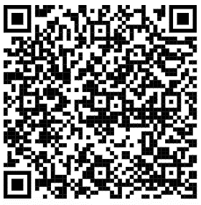

ICC Code Development Committees (CDC)
Your participation matters!
QR Code Here
Next 3-Year Cycle Applications Open
March – 1 June 2023
Notes:
Quick note that it is important for people to get involved.

Slide 3
Codes Development Discussion
Panel Discussion
Q&A Session
Standards Development Discussion
Panel Discussion
Q&A Session
Guide Development Discussion
Panel Discussion
Q&A Session
Closing Remarks
Agenda
Notes:
Quick introduction of the flow for the session so everyone understands what we will be doing.
Introduction of the panel

Slide 4

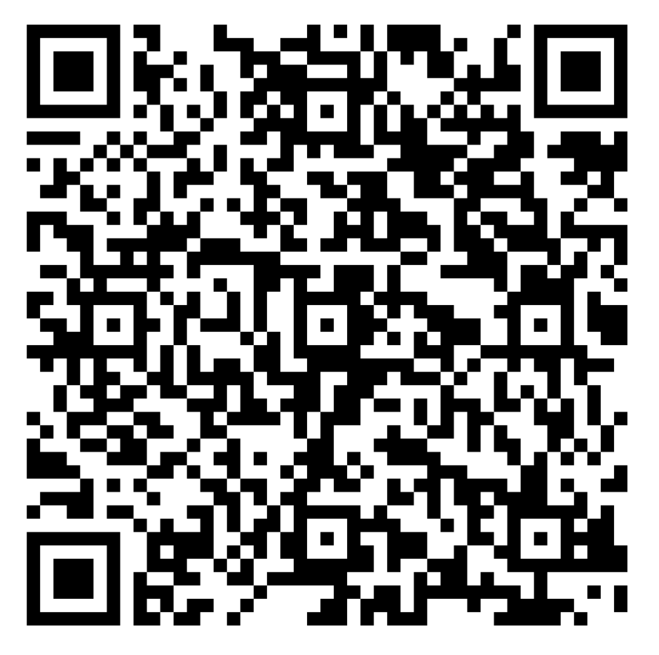
Got a Question?
Notes:
We will introduce the team and note that if people would like to enter ask questions they can either do that using the available form or verbally during the QA breaks.
Russ will monitor this for use during the panel Q&A session

Slide 5

CP 28-05 Code Development
Codes
Codes Development Details
How does the codes development process work?
What is new in the process?

Slide 6


















Comparison of Code Development Process
Good to use
CP 28-05 Code Development
Group A
Group B
Year 1
Year 2
Year 3
Jan
Apr
Sept
Nov
Jan
Apr
Sept
Nov
Jan
Apr
May
Oct
Dec
CC Due*
CAH
(11 days, 2 Tracks)
PCH
(7 days, 1 Tracks)
OGCV
(2 weeks)
CC Due*
CAH
(11 days, 2 Tracks)
PCH
(7 days, 1 Track)
OGCV
(2 weeks)
Publication
New Edition
(2024 Codes)
Current
CDC & IC Application & Selection for next cycle
2021
CDCs & Public
2022
CDCs & Public
2023
CC Due*
CAH #1
(9 days, 2 Tracks)
CAH #2
(9 days, 2 Tracks)
CC Due*
CAH #1
(9 days, 2 Tracks)
CAH #2
(9 days, 2 Tracks)
PCH (A&B)
(10 days, 1 Track)
OGCV (A&B)
(3 weeks)
New Edition
(2027 Codes)
New
CDCs & Public
CDCs & Public
CDCs & Public
CDCs & Public
Starting 2024
2025
2026
Publication
Code Process Information
Acronyms
Notes
CAC – Code Action Committees
CAH – Committee Action Hearing
CC – Code Changes
CDC – Code Development Committees
PC – Public Comments
PCH – Public Comment Hearing
OGCV – Online Government Consensus Voting
* via cdpAccess
Notes:
Russ will discuss and use with discussion with Ed

Slide 7
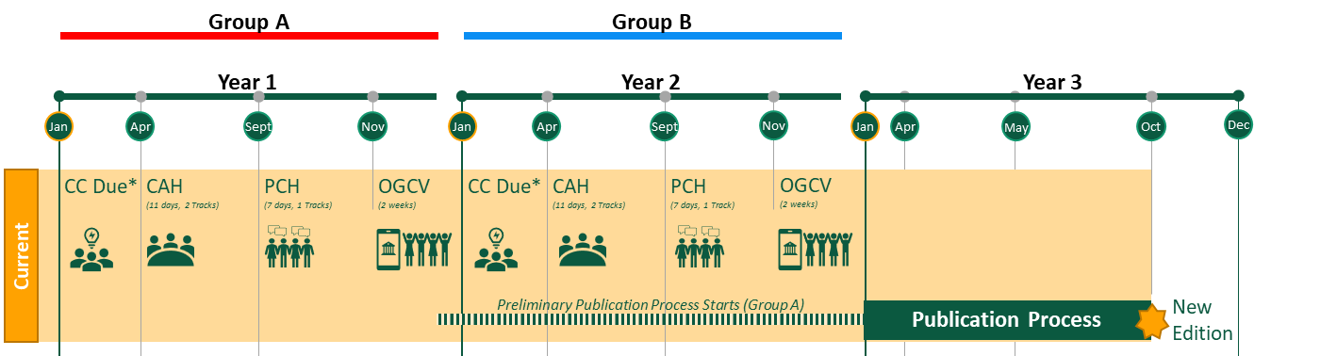
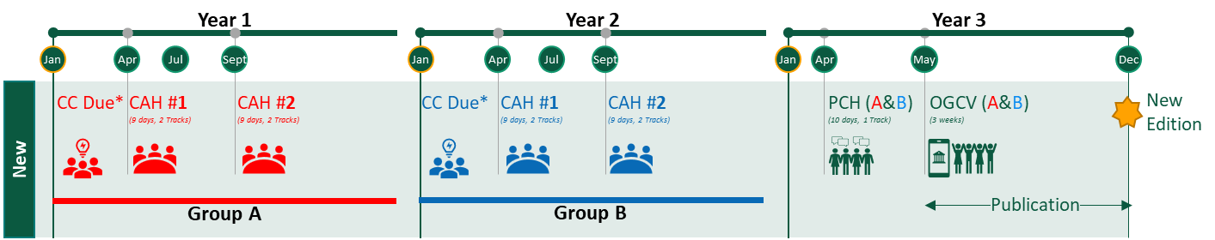
CAC Assignments Transition Coordination
Good to use
CP 28-05 Code Development
Jan
Jan
Jan
3 years
3 years
3 years
Code Cycle | Current (2021-2023)
Code Cycle | New (2024-2026)
Code Cycle | New (2027-2029)
CAC Appointments (3 years)
January 2020– December 2022
CAC Appointments (3.5 years)
January 1, 2023 – June 30, 2026
CAC Appointments (3 years)
July 2026– July 2029
3-year cycles continue
Transition Year
Transition year will allow shifting of the standard CAC 3-year cycle to support the new code process.
Notes:
Russ will ask the panel questions using this slide

Slide 8
New Codes Process Discussion
Good to use
CP 28-05 Code Development
Starting 2024
2025
2026
Year 1
Year 2
Year 3 (Estimated)
Jan
Apr
Jul
Oct
Jan
Apr
Jul
Oct
Jan
Apr
May
Dec
CC Due*
CAH #1
(9 days, 2 Tracks)
CAH #2
(9 days, 2 Tracks)
CC Due*
CAH #1
(9 days, 2 Tracks)
CAH #2
(9 days, 2 Tracks)
PCH (A&B)
(10 days, 1 Track)
OGCV (A&B)
(3 weeks)
New Edition
New
Group A
Group B
Publication
Comments / Modifications in Response to CAH#1
PC Group A Due*
Comments / Modifications in Response to CAH#1
PC Group B Due*
CCC Resolves Conflicting Actions (see 14.2 of CP 28)
CAC, CCC, CDC & IC Application & Selection for next cycle
New Standards Complete NLT
Code Process Information
Acronyms
Notes
CAC – Code Action Committees
CAH – Committee Action Hearing
CC – Code Changes
CDC – Code Development Committees
PC – Public Comments
PCH – Public Comment Hearing
OGCV – Online Government Consensus Vote
* via cdpAccess
Notes:
Russ will ask the panel questions using this slide

Slide 9
Progression to Consensus or Individual Vote
Good to use
CP 28-05 Code Development
Final Completed Action
Year 1 & 2 (Group A& B)
Year 3 (Group A & B)
CAH#1
Combined
PCH
Consent
Agenda
(Voice Vote)
Comments
in response
to CAH#1
No
“Me Too” Comments (or equivalent) are not considered a triggering comment and will proceed to Consent Agenda.
50% + 1 (simple majority) for Approval “As Submitted” and Approval “As Modified” and “Disapproved”
Year 1 & 2 (Group A& B)
Comments to the First Committee Action Hearing
CAH#2
Public
Comments
Yes
No
Year 3 (Group A & B)
Year 3 (Group A & B)
Combined
PCH
Individual
Consideration
Agenda & Vote
OGCV
50% + 1 (simple majority) for Approval “As Submitted” and Approval “As Modified” and “Disapproved”
Yes
Public Comments close for each group in their respective year.
50% + 1 (simple majority) to concur with CAH#2 action (“As Submitted”, “As Modified”, or “Disapproval”)
2/3 for Approval for “As Modified Public Comment” at PCH
Two Voting Options (See 11.1 in CP 28)
Add to PCH votes (cumulative)
Group A (Year 1)
Group B (Year 2)
Year 3 (Group A & B PCH and OGCV Combined)
Notes:
Russ will ask the panel questions using this slide

Slide 10



3 Disapprovals Rule
Good to use
CP 28-05 Code Development
1
2
3
Opportunity to Build Consensus
Opportunity to correct issues/problems
Opportunity for Comment to CAH#1 action
Opportunity to Build Consensus
Opportunity to correct issues/problems
Opportunity for Public Comment
CAH#1
CAH#2
Combined
PCH
Discussion & Vote
No Further Action in Current Cycle
Disapproved
Disapproved
Disapproved
=
Notes:
Russ will ask the panel questions using this slide
Talking Points:
Balance committees without singular “dominance”
Encourages consensus building by proponent's vs delaying for interested party overrides at end of process
Prevents bad code from being implemented into codes
Only code changes discussed at CAH#1 & CAH#2 are eligible for public comment at the PCH (code changes with no comments after CAH#1 go straight to PCH Consensus Agenda)

Slide 11

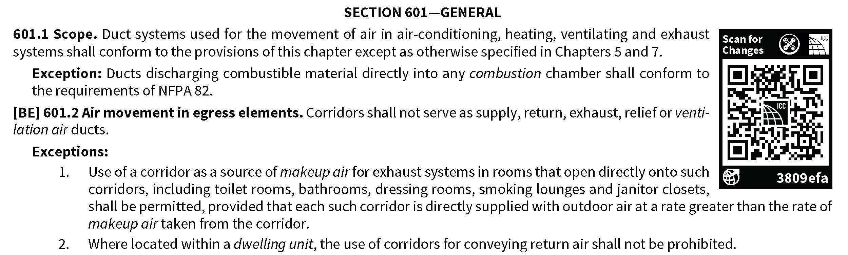
New Look for the 2024 International Codes
Now in Single-Column Format
Enhanced Graphics & Table shading
QR codes replacing margin markings to identify code changes more accurately
NFC Tags added to printed copies for authentication and Digital Premium Value added
and more enhancements on the way!
Sample

Slide 12
ICC Code Development Committees (CDC)
Your participation matters!
QR Code Here
Next 3-Year Cycle Applications Open
March – 1 June 2023

Slide 13
Got a Question?
Notes:
As we move to the final QA session we want to put this on the screen for folks one last time.

Slide 14

Standards
Standards Development Details
How does the standards development process work?
What are the new standards?

Slide 15
Draft | Not for use yet | Need to review w/Mike
Standards Video
Notes:
Karl would like to run this video at the start of the standards session. Will be a good change to the engagement and support the transition point.

Slide 16







Standard Development Process
Publish
5
6
Finalize
Iterate
4n
Balloting and Accreditation Approval
Public Comment and Resolution
4b
4
Comment
4a
Review Public Comments
3
Select
Select Committee
2
Draft
Initial Draft
1
Updates
Ideate
Identify need and scope

Slide 17
Got a Question?
Notes:
As we move to the final QA session we want to put this on the screen for folks one last time.

Slide 18

Guides
Guideline Development Details
How does the guide development process work?

Slide 19
Good to use
Guide Development Process
CP 33-08 Guide Development
Source: CP 33-08 | 2022
Identification of the subject area
Assessment of need
Appointment of Project Manager
  Possibly develop an initial staff draft (best practice)
Appointment of Guideline Development Committee
Creation of draft Guideline
Public comment
Publication
9 – 18 +/- Months
ICC Internal
1
2-3 months +/-
Ideate
2
6-12 months +/-
Develop
3
1-3 months +/-
Publish
NOTE: Non-mandatory language
Notes:
Russ will ask the panel questions using this slide

Slide 20
Got a Question?
Notes:
As we move to the final QA session we want to put this on the screen for folks one last time.

Slide 21
Get involved today!
Join a development committee.
Thank You!
QR Code Here
Next 3-Year Cycle Applications Open
March – 1 June 2023
Notes:
As we move to our closing comments we want to put this back up on the screen to encourage folks to apply.

