Slide 1

ICC Chapter Leader Academy
2023
A new blueprint to Chapter engagement

Slide 2
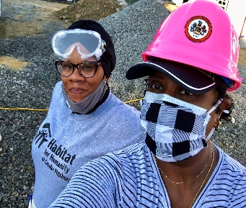
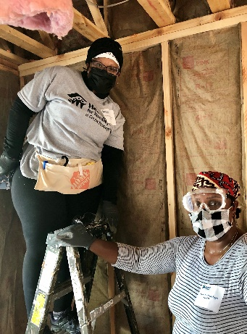
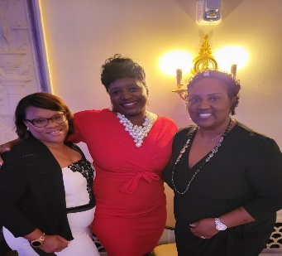
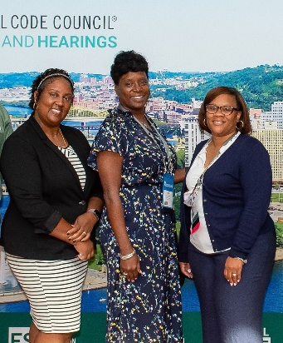
Presenters
Christina Jackson
Senior Code Compliance Inspector
City of Newport News, VA
Secretary, National Women in Code Enforcement and Development
Founding member and Past President, Women in Code Enforcement and Development of VA (WICED of VA)
Education Committee Chair, Virginia Building and Code Officials Association (VBCOA)
Maryia Lackansingh
Engineer III/Code Specialist III
Fairfax County, VA
President, Women in Code Enforcement and Development of VA (WICED of VA)
Instructor, Virginia Building Code Academy

Slide 3

Tell us who you are …..you might be surprised!
Take 5 mins
Instructions: Draw a sun, a river, tree, snake and house.
Do it on your own and make sure your drawing is not influenced by anyone or anything.
Notes:
CHRISTINA- ICE Breaker -
Ensure paper and pens are available for entire class.

Slide 4
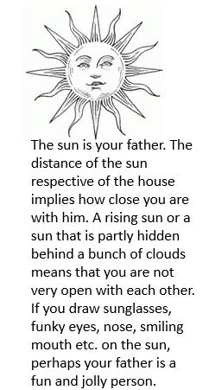
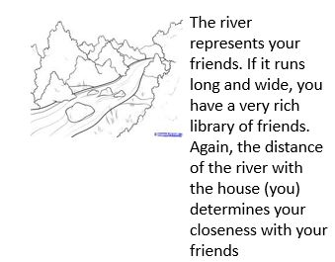
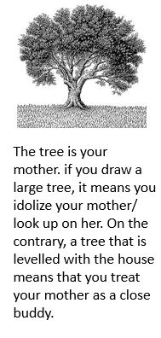

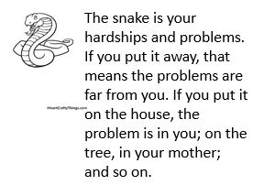
Learn about yourself
Notes:
CHRISTINA-This personality test is done in colleges and those who are studying in many Interdisciplinary Studies to help them better prepare for their field of work. This is done to help elicit information about a person motivations, preferences, interests, emotional make-up and style of interacting with people and situations. The reason for this personality test is to evaluate how to approach your outreach for your chapter. Understanding your motives and your interpersonal relationships help with your outreach and maybe who to put in your team to help you with your outreach.
ASK for 4 volunteers to come up and share their phtos

Slide 5

Let's talk outreach and growing your chapter!

Slide 6

Chapter outreach and community
Education
Support
Service
Notes:
MARYIA- What is community? – Community is can be where our work touches a physical location (like a neighborhood or gathering places) or perhaps it’s a specific group of people!
Community is the places where we live, where we work, and where we play. It’s the location of our chapters.
So why is it so important?…. The work we do within our chapters is important, and people within our communities might not know we are here or they might not know what we do….
In general we see three ways for a chapter to be involved with their communities.
The first being Education…
CHRISTINA-
Education – increase knowledge of your chapter within the community, have community events maybe tie those events to educating the community on building safety and building codes. The next items I want to discuss is
Support – what can we do to help in uplifting our communities, what initiatives are already out there that your chapter can tap into or create. I’m asking questions that I hope with spark a thought or idea.
Service – Does your chapter have a presence in your community? If not, do something about that- find ways to connect your chapter’s purpose/mission with the community you serve!
For example: You can establish relationships with locate hardware stores, home depots, or Lowes and a few times a year you can set up booths or a table on the weekend and educate the contractors and homeowners coming in to purchase supplies for their next DIY project.

Slide 7

Making Connections
Increase visibility/awareness
Chapter perception (image)
Engaging the next generation
Notes:
MARYIA- So we just touched on what you need to do while establishing outreach in your community with EDUCATION, SUPPORT and SERVICE
But what does that look like?… Does your community know your organization even exists? Do they know what you have to offer? If you answered No to either of those questions than you need to Increase your chapter’s visibility or awareness.
And While you're out there increasing the visibility of your chapter be mindful of the perception you are putting out there.
What do you want the world to know when they hear about your chapter? While conversing about your chapter find ways to improve the overall image of your chapter and of the code enforcement profession …. This can be achieved many ways including through social media.
And this leads me to our last bullet- Engaging the next generation.
Finding new and innovative ways of engaging the next generation of chapter members and/or future code professionals may seem daunting, but it doesn’t have to be.

Slide 8

What to consider when engaging your community
Why is this beneficial to our organization and mission?
How do we currently engage in your community?
Does our mission support community engagement?
What is the need of the community?
What ways do we want to be involved in our community?
Notes:
CHRISTINA- Here are some questions we want you to think about as we continue our presentation, and may this presentation spark new interest and new ideas for your chapters… Read some of the questions out loud.
In addition to these questions think about When and where is the best time to volunteer or be engaged: ex Summertime at festivals? Wintertime at housing exhibits? Or Volunteering after a natural disaster?

Slide 9

Notes:
WICED of VA thought about some of those questions on the previous slide and though community partnerships and mutual interest and understanding- we have initiated a new way of engaging a particular part of our community.
Next slide-

Slide 10


A new initiative!
Creating mini college campus chapters
    Build campus connections
    Create a blueprint for campus chapters
    Education/training opportunities
    Support/mentor students
Notes:
MARYIA- Our chapter’s mission has always been to outreach and educate the next generation of code officials; however, this year we are starting a new initiative of creating college campus chapters of WICED of VA. These are sub- chapters of WICED of VA that operate like other campus organizations or clubs.
We are tapping into an untapped market by bringing chapter awareness to college students and college campuses- We are building meaningful connections with local colleges and university and their students. This partnership is allowing us to tap into students individually. We doing this by creating a formal process or framework for which these sub-chapters or campus chapters work within. As the parent chapter- we provide educational and training opportunities to them. We act as mentors to these students, and we support them as they are pursuing careers in Architecture, Construction management, project management, and tother related fields. While also educating them on the code profession! WE are creating a “blueprint” for what these sub chapters are, how they operate, and how this partnership benefits both Parent and Child chapter. What better way to reach the next generation of future code professionals than in college. Most college students are focused, determined, and financially vested in their futures.
Next slide

Slide 11


A blueprint to creating sub-chapters
Organization structure
Mission/Vision
Resources
Mentorship
Notes:
CHRISTINA-
Similar to how many of our organizations are structured, We are here to help these students establish what their campus organization looks like, while respecting and maintaining the Parent Chapters mission/vision/goals.
* It is important to get by-in from the college or university AND from the students.
(ADD your personal notes)
Discuss what each of these bullet points mean as it relates to creating a new campus chapter
Discuss How WICED is planning to support our First Campus chapter. (we are currently working out the kinks- like first time parents)

Slide 12


Build campus connections
Notes:
CHRISTINA- Talk about Vernell, his connection to us,…also a former instructor/mentor for the Virginia Building Code Academy, talk about his tenure at Norfolk State University and the connection built with WICED of VA.

Slide 13

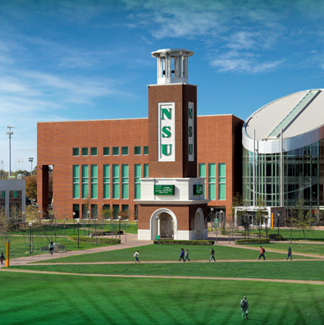
Education and Training Opportunies
Notes:
CHRISTINA- Find ways for your chapter to support these campus chapters. Offer trainings and presentations specific to the students and their areas of study.
Hold campus events – to educate and increase campus membership. remember to supply food, games, goodies

Slide 14


Support and Mentor Students
Notes:
Maryia- Remember who you are- circle back to ICE BREAKER. How can “who you are” help you to support, connect, relate, and mentor these students.
Be available to students. Be a resource.
Offer volunteer hours for student membership
Incentives for membership to get scholarships
Offer lunch days and gift cards for members who attend
Look for events or services related to the mission or work of the chapter – H4H women’s build for example…
Maryia- touch on this year’s event next week My 3rd. And that our student members will be joining us on site ☺

Slide 15
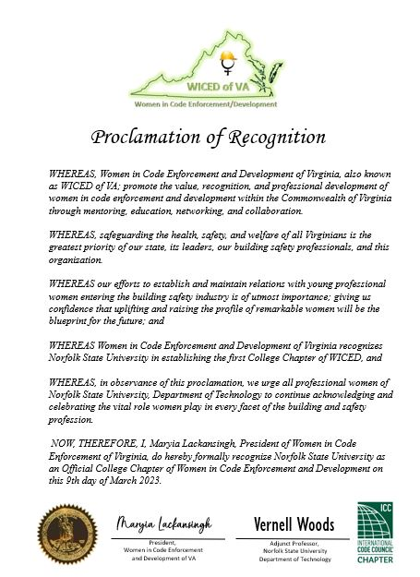
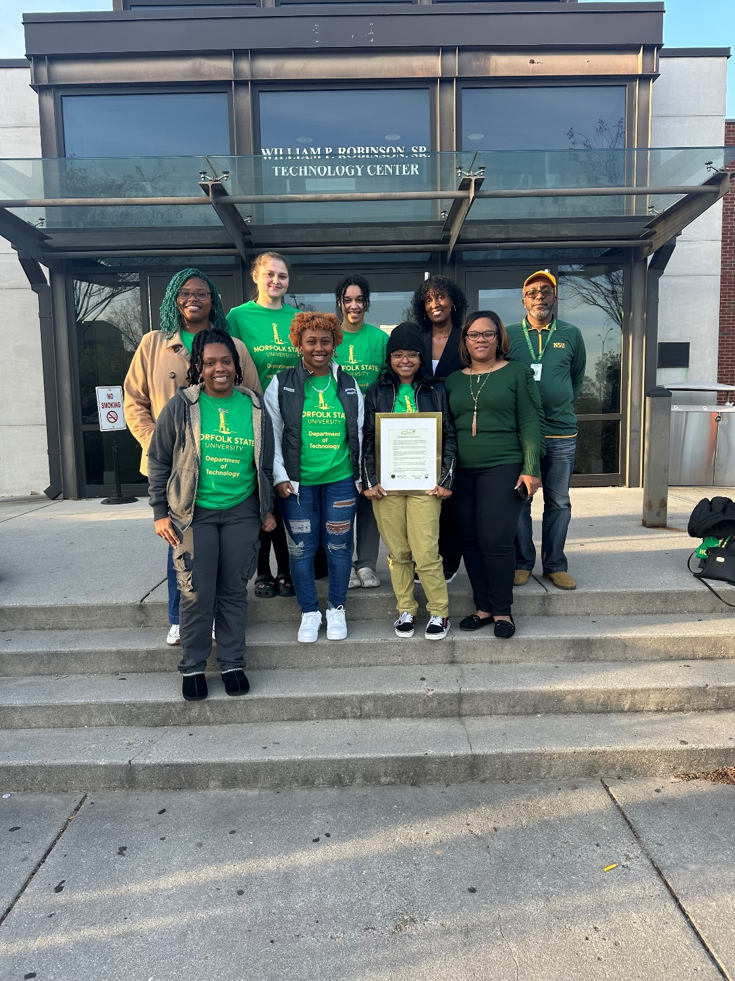
Notes:
Maryia- This is the proclamation of recognition we presented to Norfolk State University’s Department of Technology. Their professor and campus chapter adviser, Vernell Woods, submitted WICED of VA student applications all his female students. This is a photo of a few of those ladies.
Christina- … add any notes you want ☺

Slide 16
Chapter Challenges

Slide 17

Challenges facing Chapters
Mission does not support
Lack of chapter commitment
Lack of member or other resources
Geography too large
Notes:
CHRISTINA- (Add your notes to this slide)
Minimize your Challenges- Stay in touch with past volunteer organizations
Co-sponsor training with other code organizations
Be a part of changing the image of code enforcement

Slide 18
Minimize your Challenges
  Stay in touch with past volunteer organizations
  Co-sponsor training with other code organizations
  Be a part of changing the image of code enforcement
Notes:
Christina- Be a frequent volunteer – establish relationships with these groups so they see you an ongoing resource.
Partnering with other code organizations broadens your reach, impact, and strengthens relationships within the chapters and its members.

Slide 19
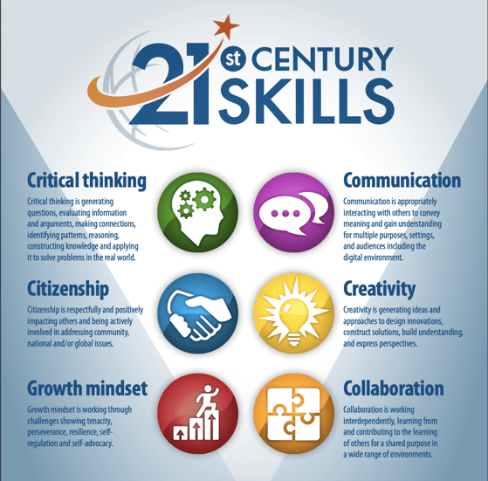
Follow the 4 C’s of how you want to deliver your chapter’s message
Notes:
Christina- Career readiness means equipping students with a nuanced set of skills that can prepare them for the unknown.
Social media has changed human interaction and created new challenges in navigating social situations.
The age of the Internet has dramatically increased access to knowledge. Students need to learn how to process and analyze large amounts of information.
Content knowledge from core subjects can only go so far; students need to be taught how to apply facts and ideas towards complex problems.
Learning Skills: Also known as the "four Cs" of 21st century learning, these include critical thinking, communication, collaboration, and creativity.
Life Skills: Flexibility, initiative, social skills, productivity, leadership
Literacy Skills: Information literacy, media literacy, technology literacy

Slide 20
Keeping your name/organization positive
Ensure membership and community are benefiting from efforts
Let your organization expertise be a resource for people
Say yes (or maybe) when possible
Notes:
Christina/Maryia

Slide 21
Last Thoughts
Have chapter buy-in
Think outside the box
Ensure efforts are valuable to the chapter, members, and the community
Be an Asset to Your Community
Notes:
Christina/Maryia

Slide 22
What questions do you have for us?
Notes:
We hope we sparked some ideas for you

