Slide 1
LEADERSHIP SKILLS
A MILLENNIAL PERSPECTIVE
ANDRE JAEN MCP

Slide 2
Who am I and why and I here?
This is my wife Cait.

Slide 3
Who are you?

Slide 4
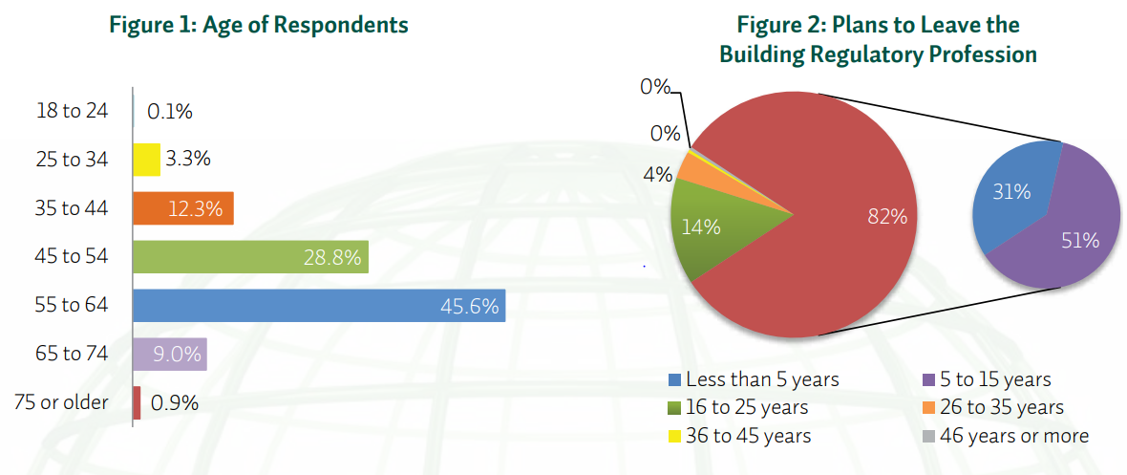
The elephant in the room.
A looming shortfall of building officials.
NIBS Study August 2013

Slide 5
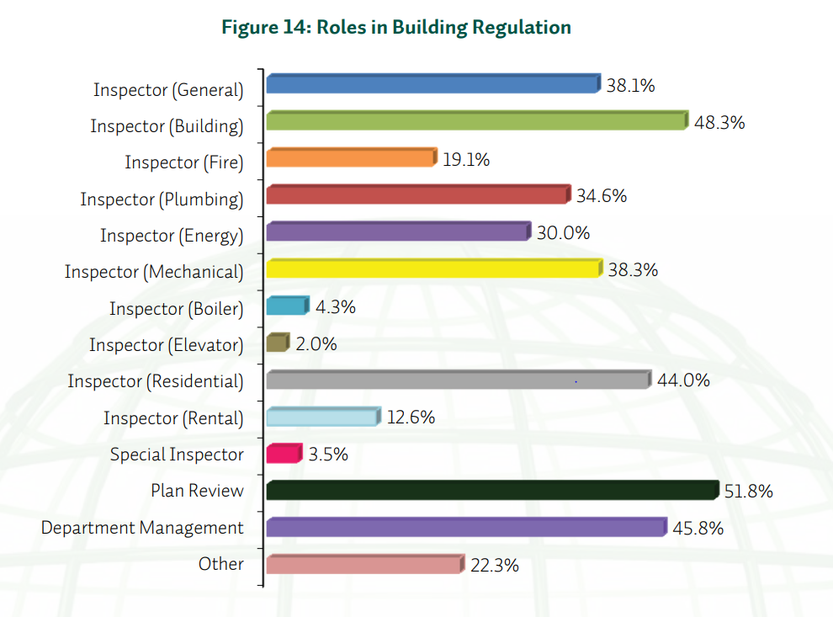
Skills and assets
The retirement cliff
Skills and Assets Shortage

Slide 6
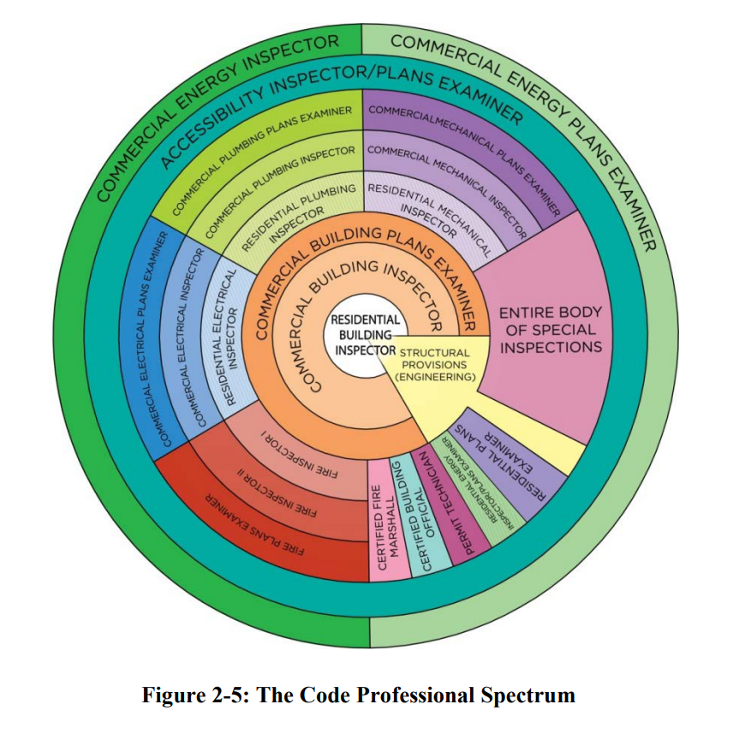
The Modern Building Inspector
Assessing the Repercussions of Mass Retirement of Building Officials in the State of Utah
BYU 2015

Slide 7
What is missing from that picture?

Slide 8
What leadership skills do you want to save?

Slide 9
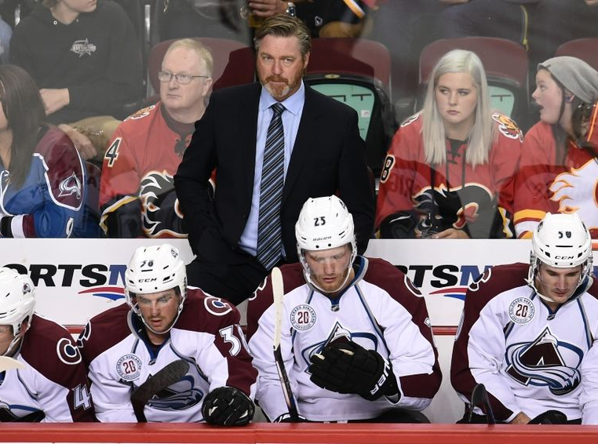
Coaches and Captains
Benjamin Hochman, The Denver Post
Benjamin Hochman, The Denver Post
Candice Ward USA Today

Slide 10
Coaches and Captains
Coaches
CAPTAINS

Slide 11
Captains
The on the job skill set that develops daily decision makers with good judgement.
Their function is as a coordinator and facilitator.
They are the lynchpin of the team.
We are excellent at producing these through our regular education and training.

Slide 12
Coaches
Offer an overall vision to the team.
Focus on a number of objectives, some outside of their own expertise.
Understand the mechanics and operations of everyone’s position. It doesn’t mean they’re the best at it.
Manages upward and downward.
This is what we need to develop.

Slide 13
Vision
Core beliefs shape vision and
create passion.
What are your core values?
How do you pass on your passion
without demanding others
share your values?
"Your beautiful eyes" by Suren Manvelyan is licensed under CC BY-NC-SA 4.0

Slide 14
The difference to a leader is training vs mentoring.
Mentoring is a brain to pick, an ear to listen and a push in the right direction.
-John Crosby

Slide 15
Why are chapters so important to this model?
Experimentation
Social/Professional Networking
Passion for their vision
Failure without fear

Slide 16
Who are you and why are you here?
You clearly are doing something right.
What is it?
What could you be doing better?
What guidance do you have for someone else?

Slide 17
Wrapping up…
Skills shortage
We must prioritize what skills we think we need.
The traditional model is shifting.
Coaches and Captains
Leadership skills vary in response to needs and expectations.
Not all players are coaches, and there’s only one coach on a team.
Is every captain ready to coach a team?
Vision
Leadership requires vision, and vision is driven by beliefs.
Inspiring new leaders needs to leave room for their vision too.

Slide 18
Thank you
Andre Jaen
ajaen@Jeffco.us
303-271-8252

