Slide 1
2023 ICC Chapter Leadership Academy
Building Coalitions: The Secret to Chapter Success

Slide 2
Chapter Goals:
Increase Membership
Generate Revenue
Provide a service:
  Education
  Networking opportunities
  Providing information on issues of common interest

Slide 3
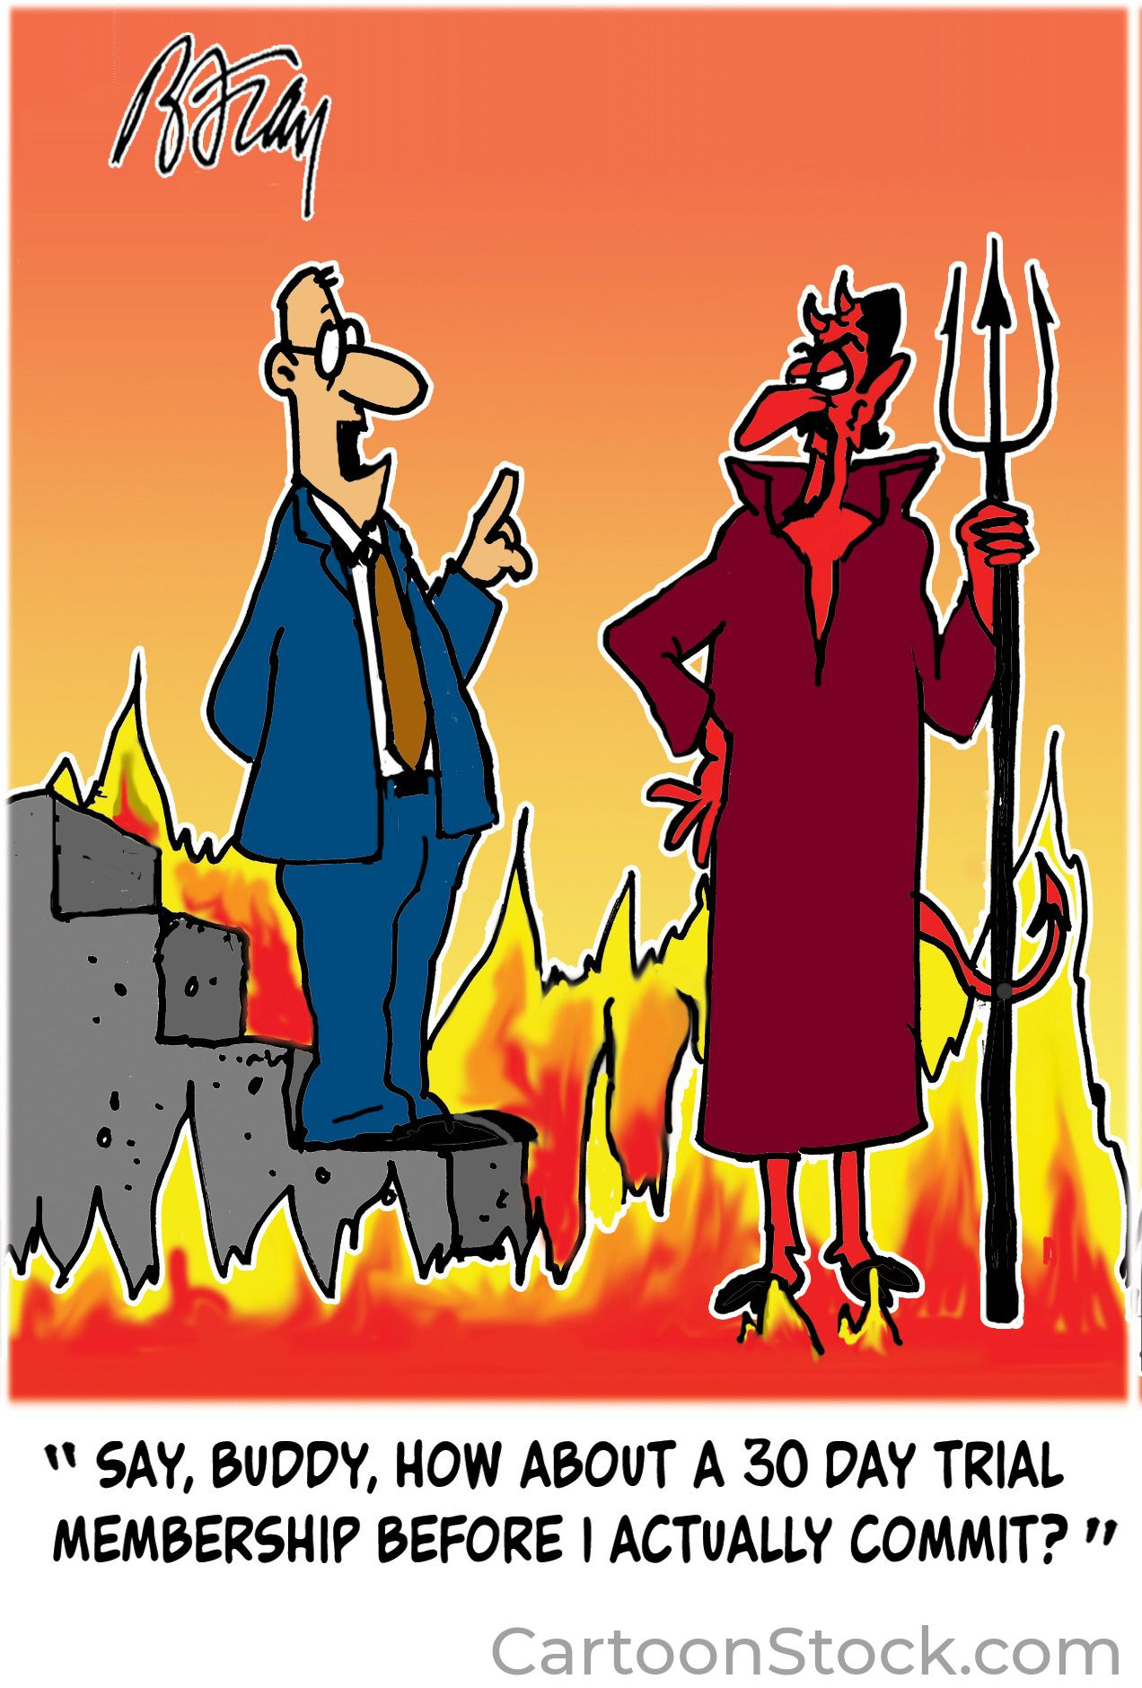
Increasing Membership
“I refuse to join any club that would have me as a member” – Groucho Marx

Slide 4
What has been successful for your chapter?

Slide 5
Coalition Building
“You win by working hard, making tough decisions and building strong coalitions” – John Engler

Slide 6
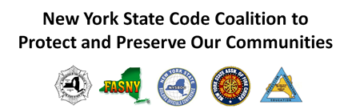
NY Chapters that formed a strong coalition

Slide 7
Members of the NYS Code Coalition
New York State Building Officials Conference (NYSBOC)
  2000 members
New York State Association of Fire Chiefs (NYSAFC)
Firefighters Association of New York (FASNY)
  50,000 members
New York State Fire Marshals & Inspectors Association
Association of Fire Districts of the State of New York
  57 counties outside of NYC

Slide 8
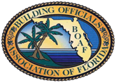



Building Officials Association of Florida
Local chapters representing the entire state as well as the FL chapter of the International Association of Electrical Inspectors and the Florida Association of Plumbing-Gas-Mechanical Inspectors Association.
All code professionals with different disciplines

Slide 9





Other Examples of Coalitions
Monroe County, NY
Nassau County, NY

Slide 10
Legislative, Regulatory, Code Development Issues
Submitting letters/memos with logos of coalition members
Social Media/Radio/TV highlighting list of organizations in support or opposed to various topic
If lobbying or advocating using name tags with the logos of coalition members so you are clearly identified
Be consistent with the layout of the logos so it becomes a “brand”

Slide 11
Have you created or participated in a Coalition?

Slide 12

ICC & NFPA
Founders
Approximately 100 member organizations
  Non-profits
  Chapters
  Government – federal, state, local
  Educational Institutions
  Corporations
  Manufacturers
  Individuals

Slide 13
“Even business rivals can build trust quickly and find a shared purpose because of their similarities and prior relationships”
Harvard Business Review
Successful Coalitions utilize the strengths & unique qualities of their Members to achieve common goals
Members might not agree with everything, but can agree on the goal at hand and work together to achieve that goal
CCSC

Slide 14
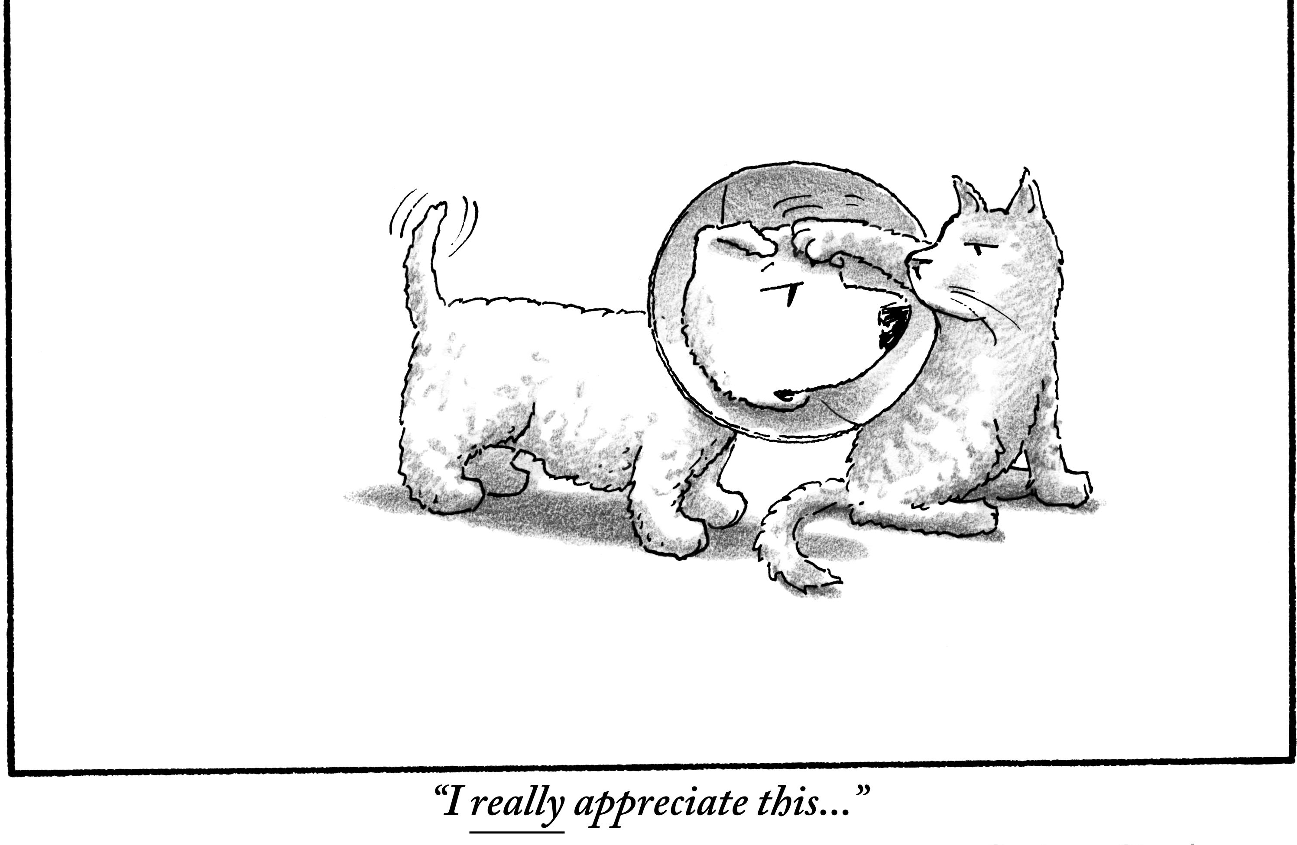

Slide 15
Building Coalitions for a Common Goal
The Covid-19 Healthcare Coalition (C19HCC), which began in March 2020, is a case in point. A small group of dedicated leaders from 18 diverse organizations, including Amazon Web Services, Epic, Mayo Clinic, and Microsoft, came together quickly to mount a private-sector pandemic response contributing to national and state government efforts. They in turn brought in contacts of their own to create a coalition of more than 1,000 organizations in 16 working groups.
  Harvard Business Review

Slide 16
Getting everyone possible involved
Sometimes our strongest opponent becomes our great supporter

Slide 17


Slide 18
Active Participation/Effective Communication
Monthly, Quarterly, Annual
Reception/Conference
Email Updates/Follow up
Accurate Website

Slide 19
Other ideas to keep active participation in the Coalition?

