Slide 1
Creating a Building Safety Career Path
June 4, 2019

Slide 2
Overview
Why building safety?
Entry point
Career options
Career path components
Milestones
Leadership
Succession

Slide 3
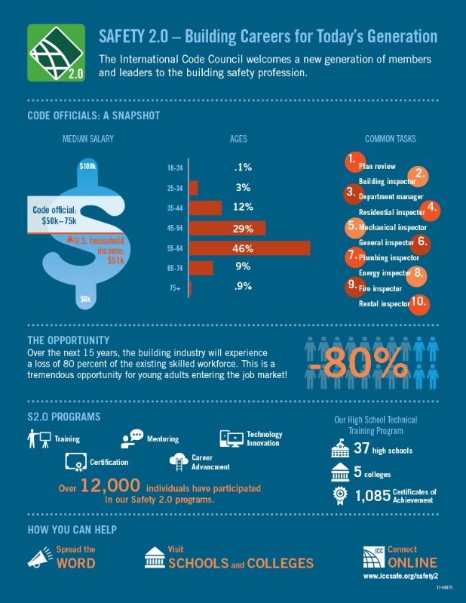
Why Building Safety?
Expanding opportunities
NIBS report
Alternative to college
Clear mission
Stability
Portability
Notes:
Add statistic re: % of code official retirements in the next 5 years
Graphic re: Code Officials a snapshot?
Opportunity to enter a career without college degree
Clear mission

Slide 4
Entry Point
High school
College
Design professionals
Military
Construction trades
Career change
Notes:
High school
College
Military
Construction trades

Slide 5
Career Options
Public sector
Building department
Fire prevention
PMG
Energy
Private sector
BSSP
Consultant

Slide 6
Career Path Components
Passion
Mentor
Network
Resources
Training
Administrative
Credential
Advanced (combination)

Slide 7
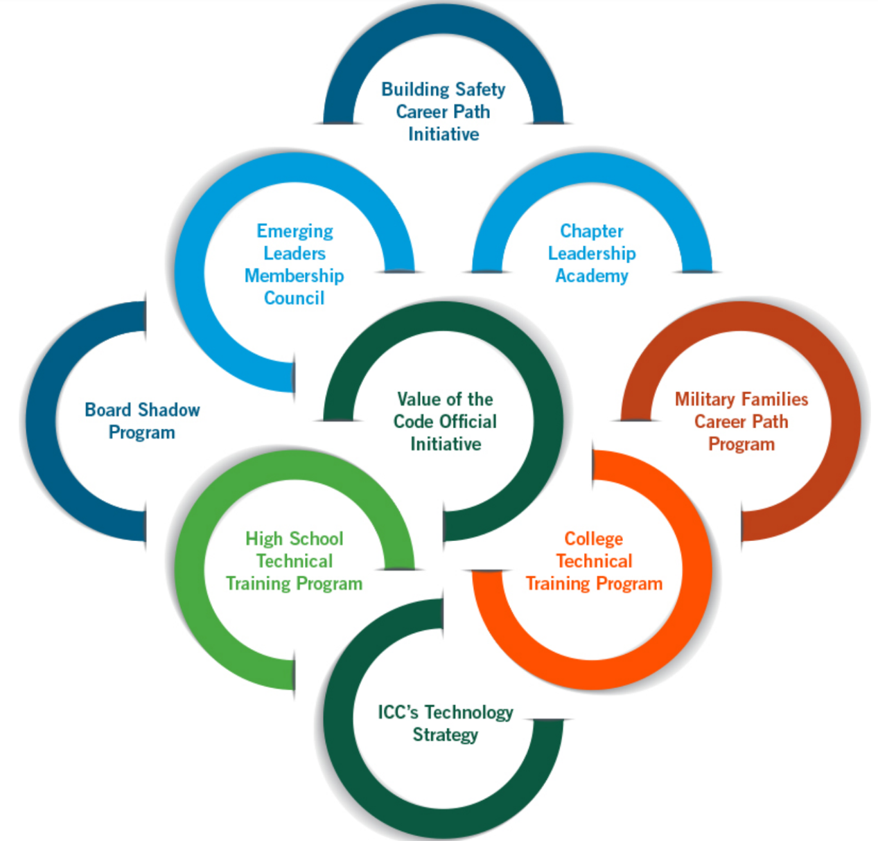
Resources – Safety 2.0

Slide 8
Resources

Slide 9
Residential Building Inspector

Slide 10
Residential Plumbing Inspector

Slide 11
Commercial Building Inspector

Slide 12
Permit Technician

Slide 13
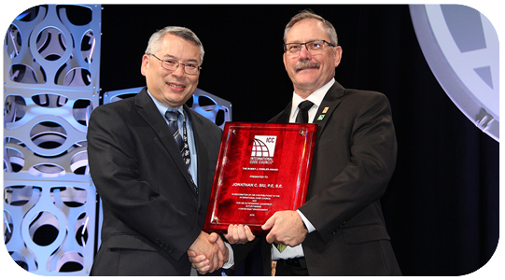
Milestones
Code Council membership
Chapter membership
Certification
Recognition
2016 Bobby J. Fowler award – Jonathan Siu

Slide 14
Leadership
Government
Building Official/Fire Marshal
Community Development Director
Volunteer
Chapter leader
Code development committee
Membership Council
Board of Directors

Slide 15
Succession
Share your wisdom
Find your replacement
Become a mentor

Slide 16
Thank you!

