Slide 1
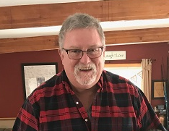
Honoring Chapter Leaders Past and Present
Wm. Scott Copp
Past President - New York State Building Officials Conference
Past President - Finger Lakes Building Officials Conference
Notes:
Introduce Jim and Jim and give your background. Highlight Brotherhood/sisterhood within Code community.
Thank ICC for the opportunity to share information on the Wm. Scott Copp award

Slide 2

Recognizing a Good Chapter Leader
Good leaders are hard to find
  They need to have the “right stuff”
Notes:
This is a general information slide. You should talk a little bit about the importance of a good leader, and that they are hard to find. There are a number of characteristics and qualities a good leader should have (the “right stuff). You will go over these in the next several slides. Highlight deeds vs. words.

Slide 3
Quote for the Day
If your actions inspire others to dream more, learn more, do more and become more,
YOU ARE A LEADER
Notes:
Saw this on a recent inspection at large Amazon project and thought it a fitting inclusion for this program. Stress “Actions”

Slide 4
Characteristics of a Good Chapter Leader
Simple explorations of the question, “what makes a good Chapter leader?” include:
A leader is someone who inspires passion and motivation in the group, especially through deed example.
A leader is someone with a vision and the path to realizing it.
A leader is someone who ensures their team has support and the tools to achieve their goals.
A leader may be any of those things, but a good leader is all three.
Notes:
You should elaborate on these generally, but don’t apply them to Scott. This will be done in a later slide. You should apply these to the code enforcement community as a whole.

Slide 5
Qualities of a Good Chapter Leader
Knowledgeable
  Educated and well informed. Having knowledge, both “book” and experiential, especially of a particular subject.
Approachable
  Shares information. Treats everyone the same. Willing to listen.
Articulate
  Capable of sharing information clearly.
Expectation of Success
  Positive attitude. Believes in and supports the established goals.
Passionate
  Enthusiastic about the code and the organization. Goes ‘above and beyond.’
Notes:
Take some time and review each of these. Again, don’t apply them to Scott specifically because you will do that later. As you go through the list. Explain why each one is important to a successful leader of a chapter. Outline the benefits.

Slide 6
Honoring a Good Chapter Leader
What does it mean to honor someone?
  Bestowing special recognition for the work they have done.
  Acknowledging them with admiration and respect.
Why is it important to do something special for a good Chapter Leader?
  Publicly affirms the Chapters appreciation for the work done under the individuals leadership. Highlight volunteerism!
  Outlines those accomplishments.
  Memorializes the individual in the Chapter’s history.
  Encourages members to become good leaders.
Notes:
Once a Chapter finds a really good leader, it is important to recognize that individual for the work that they have done.

Slide 7
How Do We Accomplish This?
Chapter needs to determine what type of recognition is deserved.
  Based on the level of accomplishment.
    Certificate of Achievement?
    Plaque?
    Gift certificate?
What if they pass away while still actively engaged in the program?
  Posthumously award?
  You must consider the family who has likely sacrificed time with the individual.
Notes:
The difficult part of this process is deciding what should be done to recognize the leader for what they have accomplished. Obviously this is situational and personal and each Chapter will have to make this determinization, based on what the accomplishments were. It becomes more difficult if that person passes away. How do you honor that persons legacy? Regardless of how you do it, you must ensure that their family is part of the decision making process.

Slide 8
What Made Scott a Good Leader?
Knowledgeable
  Educated and well informed. Having knowledge, especially of a particular subject. (Actually, broad knowledge of many subjects)
Approachable
  Shares information. Treats everyone the same. Willing to listen.
Articulate
  Capable of sharing information clearly.
Expectation of Success
  Positive attitude. Believes in and supports the established goals.
Passionate
  Enthusiastic about the code and the organization. Goes ‘above and beyond.’
Notes:
Use this slide to show how Scott exhibited each of them. Use specific examples to underscore why he is being honored.

Slide 9
Wm. Scott Copp, experiential learning
Carpenter for Obrien Homes framing houses
Strong Museum reconfiguring spaces, display construction
Block Industries
Fire Service
38-year member Fairport Fire Department
“Learned”/ relished playing the role of Santa
14 Year Member of NYS Codes Division Board of Review
Lifelong curiosity and passion for learning: “learn something new every day”

Slide 10
Wm. Scott Copp
35 years of service to Codes:
Town of Perinton as Director of Building and Planning.
Technical Director of Compliance Services at T.Y. Lin International
Aided in NYS transition to ICBO and ultimately the I-Codes
President of NYSBOC
President of FLBOA
President of FLBOA again when no one else raised hand

Slide 11
Wm. Scott Copp
35 years of service to Codes:
Promoted FLBOA and NYSBOC to actively participate on the National stage as ICC Chapter organizations
Participated as member of the Mechanical Code Committee
Participated as member of the Energy Code Committee
Actively encouraged NYS Chapters to Participate in ICC Northeast Regional Coalition (ICC Region VI)
Made strong personal connections (e.g., ICC’s Ron Piester, Steve McDaniel, Dottie Mazzarella)

Slide 12
Honoring Scott’s Legacy
What is someone’s legacy?
  It is about the richness of the individual's life, including what that person accomplished and the impact he or she had on people and places. Ultimately, the story of a person's life reflects the individual's legacy.
Legacy is how you honor the deceased and find the aspects of them that continue on.
How best to honor Scott’s legacy?
  Involves several organizations:
    Finger Lakes Building Officials (FLBOA)
    New York State Building Officials Conference (NYSBOC)
    TyLin
    International Code Council (ICC)
  Scott’s family was involved from the beginning.
Notes:
This slide begins the discussion on what was done to honor Scott’s legacy. It starts off with a discussion on the definition of a “legacy”. The discussion on how best to move forward with this process involved the four organizations listed on the screen. Take a few minutes to review what each organization is, how they serve the code enforcement community, and how Scott served each.

Slide 13
Honoring Scott’s Legacy
FLBOA holds an annual conference for code official in-service learning
  Original idea was to call the 2022 conference the “Conference of Distinction.” Upon Scott’s passing and discussion with Jim Burton, it became imperative to:
  Recognize and memorialize Scott’s impact on the code enforcement community.
  Rename the annual FLBOA conference the “Wm. Scott Copp Educational Conference.”
  A Remembrance Coin was given to each participant in the conference. Crafted by Jim Bailey

Slide 14
Remembrance Coin

Slide 15
Honoring Scott’s Legacy
Discussion further expanded beyond our New York Chapters:
  Conversations with the Jim Burton (TYLin), ICC’s Ron Piester, Dottie Mazzarella and Steve McDaniel brought us here today.
  ICC suggested an annual award to enhance and promote the learning and growth of an outstanding Chapter Leader in scholarship form.
  Founding funding to come from FLBOA, TYLin, and NYSBOC.

Slide 16
Wm. Scott Copp Leadership Award
Applicant must meet the following criteria:
  Exhibit exceptional leadership qualities that benefit the Code Council, Chapter and or local community, and/or
  Serves as a mentor or inspiration to others interested in becoming Code Council or Chapter leaders, and/or
  Advocates for and promotes leadership opportunities in the building safety profession

Slide 17
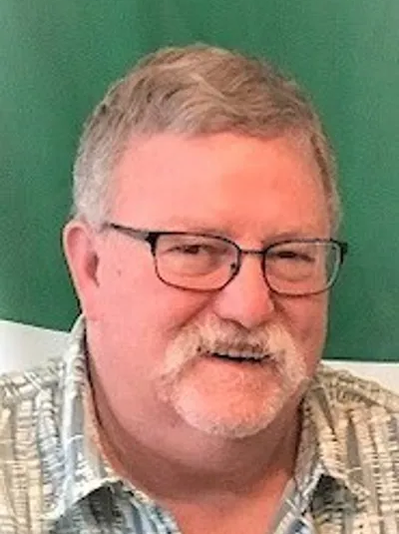
Wm. Scott Copp
Thank you for the opportunity to talk about our friend, Scott Copp.
We would be happy to answer any questions you may have.

Slide 18
Special Thanks and Acknowledgement
Special Thanks and Acknowledgement to
Eric Bradshaw
for his help in putting this program together.
Notes:
One of the of the components of a good leader that I missed is to surround yourself with quality people doing great things. Eric fills that billing to the brim.

