Slide 1
The Code Council Prepares & Welcomes a New Generation of Members and Leaders to Building Safety Professions

Slide 2
Notes:
This morning I’d like to discuss Safety 2.0. ICC’s new initiative in building careers for todays generation.

Slide 3
Highlights the Value of Code Officials
Highlights Career Development Programs
ICC Technology Strategies
Chapter leadership Academy
High School Technical Training Program
College/ Trade School Program
Military Families Career Path Program
Board Shadow Program
Emerging Leaders Membership Council
Notes:
Safety 2.0 includes ICC’s new technology strategies, the ICC Board Shadow Program, our Chapter leadership Academy, the Emerging Leaders Membership Council, our High School technical Training Program, our College and Trade School program and our new Military Families Career Path Program. I’d like to discuss the latter three programs in greater detail.

Slide 4
Career Development Programs
High School Technical Training Program
College/Trade School Program
Military Families Career Path Program
Notes:
These are our primary career development programs:
The High School Technical Training Program;
Our College/Trade School program; and
Our Military Families Career Path Program

Slide 5
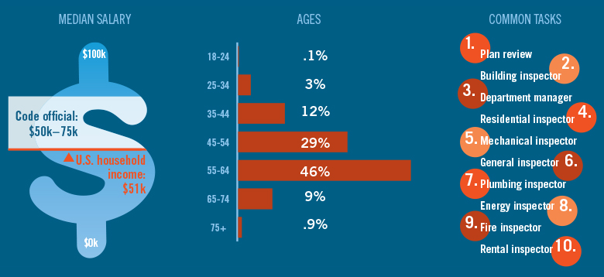
Code Official Demographics
Notes:
As you can see, a career as a code official offers diversity and incomes above the US household average. On average, code officials earn between $50,000 and $75,000 per year.

Slide 6
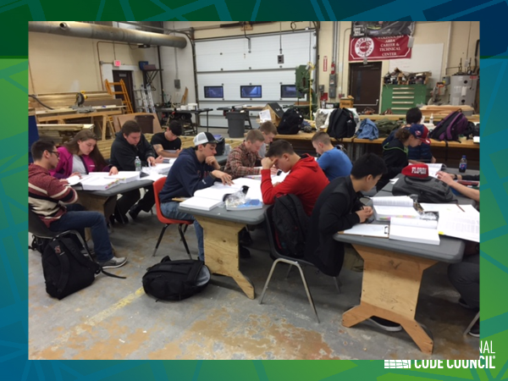
High School Technical
Training Program
ICC’s High School Technical Training Program is a flexible educational program, divided into six parts:
Building;
Plumbing;
Mechanical (HVAC);
Masonry;
Energy; and
Electrical.
This enables each High School to integrate one or more parts of the program into its current construction trade curricula and to provide students with comprehensive knowledge construction trades.
The program includes all course materials and
exams to ensure easy implementation.
Notes:
The technical high school program was established to formally introduce students to the codes associated with their trades and offer a Certificate of Completion from the ICC.
The program is based on the International Residential Code and its accompanying study companion.
Students learn how to navigate and comprehend the IRC as they work through their daily construction projects.

Slide 7
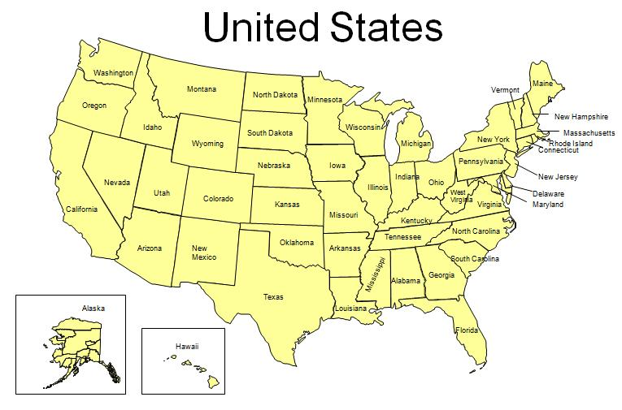
High School Technical
Training Program
20 Participating States
37 Technical High Schools
255 Student Memberships
New High Schools
California
Maine
Texas
Washington
West Virginia
DC
Notes:
There are 37 participating schools in 20 states offering students the opportunity to earn an ICC certificate of completion.
Virginia leads the nation with 16 schools in the program and was the first state to approve the ICC Certificate program to their approved credential list for 17 construction courses.
Last year Delaware revised their Architectural Engineering Technology course and included the ICC certificate program as an state approved credential.
Last year Kansas added the ICC certificate to the approved list for the construction cluster.
New schools include:
Pueblo Centennial High School, Colorado
Perris High School of Perris California
Columbia Basin Technical Skills Center, Moses Lake, Washington
Poquoson High School, Poquoson, Virginia
Carver Career Center, Charleston, West Virginia

Slide 8
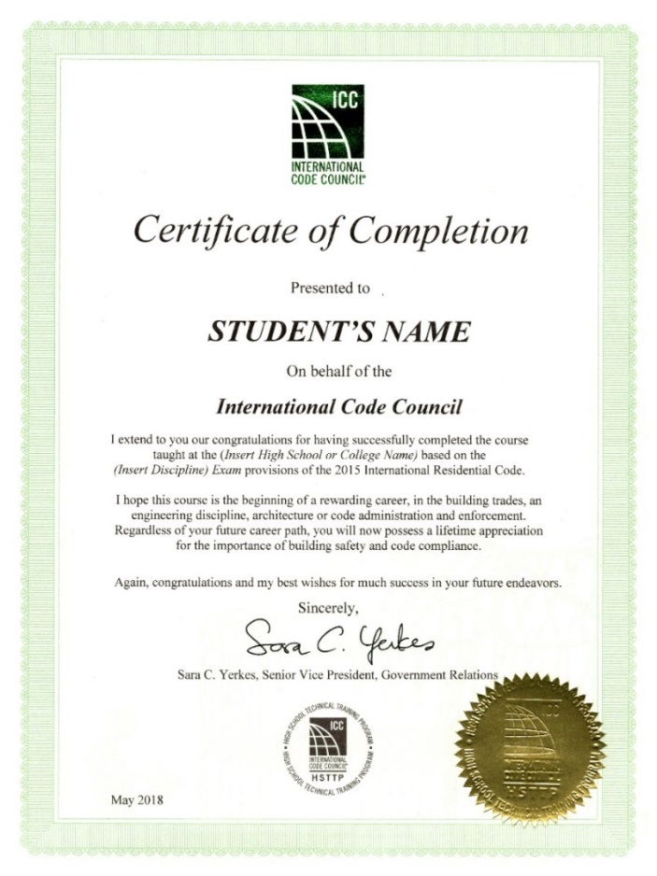
High School Technical
Training Program
Students completing all elements of one part, including a final exam, receive a nationally-recognized ICC Certificate of Completion.
1,397 Certificates of Completion awarded to High School Technical Training School students.
256 Certificates of Completion awarded to College/Trade School students.
Notes:
To date, 1,397 Certificates of Completion awarded to High School Technical Training School students and 256
Certificates of Completion awarded to College/Trade School students.
Virginia has approved the ICC’s High School Technical Training Program (HSTTP) and added the program to the list of approved industry credentials for 17 of the Architecture and Construction courses
Delaware has developed an Architectural Engineering Technology (AET) course for 2 of technical schools in Delaware and the ICC’s High School Technical Training Program (HSTTP) is one of 4 industry recognized certifications and or licenses approved for the AET course.
Kansas approved the ICC’s High School Technical Training Program (HSTTP) for the Kansas Pathway Assessments and Credentials in the Architectural and Construction Cluster

Slide 9
College/Trade School Training Program
8 Participating Colleges
Pennsylvania College of Technology Williamsport, Pennsylvania | Wilkes Community College Wilkesboro, North Carolina
Texas State Technical College Waco, Texas | Washburn Institute of Technology Washburn, Kansas
Tidewater Community College Tidewater, Virginia | Coconino Community College Flagstaff, Arizona
Texas State Technical College Harlingen, Texas | Eastern Maine Community College Bangor, Maine
College students are also taking ICC’s Residential Inspector Certification Exams.
Notes:
In our College/Trade School Program, the Pennsylvania College of Technology was the first college to offer the ICC certificate course and has operated the program for 3 years. Recently they contacted ICC about adding 12 new instructors to their membership and expanding the program starting this fall.
The Texas State Technical College introduced the program into their construction management and code curriculum a year ago in their Waco Campus and the program expanded to the Harlingen campus this year.
Tidewater, Coconino and Eastern Maine all started the program this year.

Slide 10
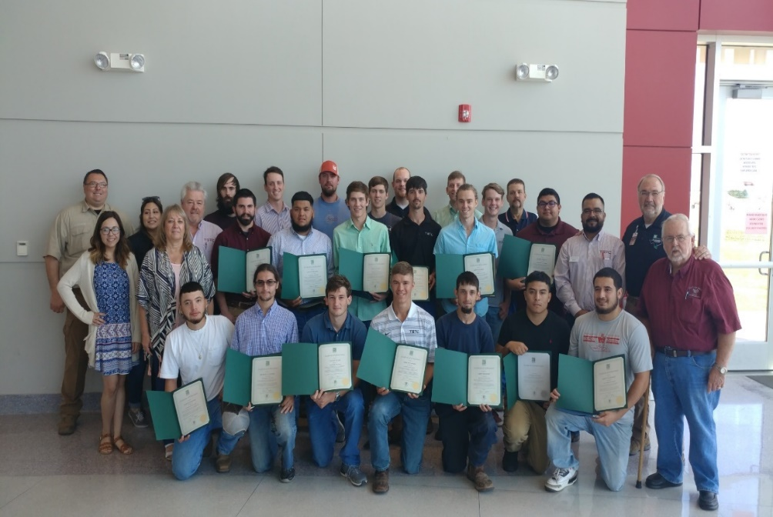
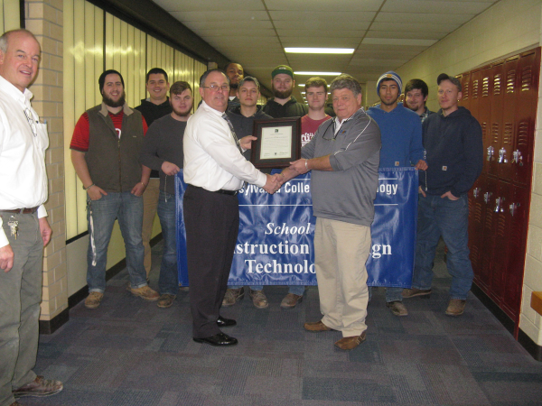
College/Trade School Training Program
Texas State Technical College
Pennsylvania College of Technology
Awarded 256 Certificates of Completion to-date
Notes:
The group from Texas State Technical College is the first group of students in Texas to receive the Certificate of Completion from the ICC. The Pennsylvania College of Technology receives their Certificate of Completion from the ICC. The majority of these students are enrolled in construction management and construction technology courses.

Slide 11
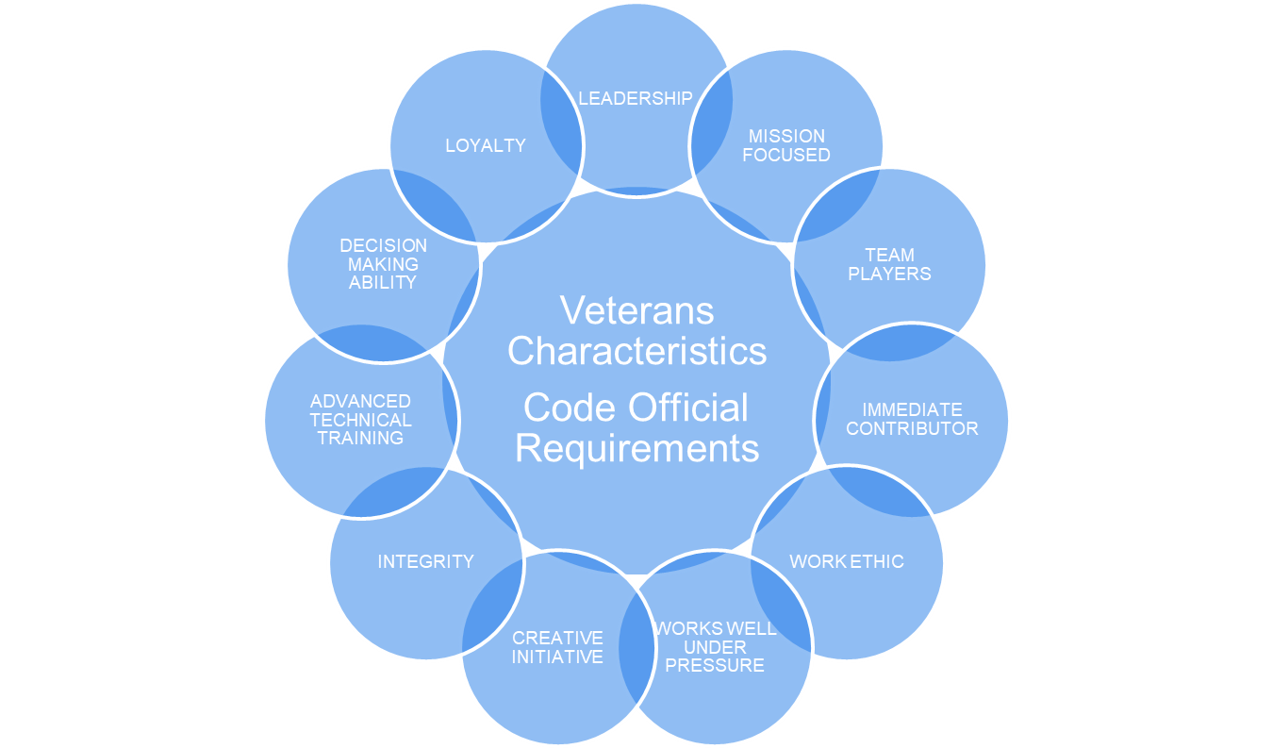
Military Families Career Path Program
Over the next 15 years, the building industry will experience a loss of 80 % of its existing skilled workforce.
Military Veterans and their families can fill that gap.
Notes:
The Military Families Career Path Program is a new program to the ICC.
The concept of the program started October 2017 at the ABM in Columbus and has been growing and developing.
Much research is going into this initiative to determine how best to reach veterans and create an interest in code enforcement as a career. As you can see, Veterans possess the same characteristics and attributes that code officials require to succeed in their daily duties.

Slide 12
Military Families Career Path Program
50% of existing code officials are military veterans.
ICC is helping veterans and their families transition to civilian life and begin careers as code officials.
Veterans are eligible for 6-month complimentary ICC Membership
“I'm sold. I'll start tomorrow as a building official or inspector. I've been proudly protecting the safety of the United States for most of my life, so I'd be proud to keep doing it through the building industry.
— Air Force Chief Master Sergeant John A. Hammonds
Notes:
A recent survey of ICC members indicated that 50% of existing code officials are military veterans.
ICC is helping veterans and their families transition to civilian life and begin careers as code officials. ICC is also offering a complimentary 6-month membership to ICC to all military veterans so they may gain additional insight about ICC and the members we serve.

Slide 13
Military Families Career Path Program
The ICC Learning Center offers a variety of online training programs focused on residential construction and minimum code requirements.
Single day Seminars offering targeted information on a specific topic.
Veterans are eligible for reimbursement through GI Bill
Notes:
The Learning Center is a significant part of the Military Families Career Path Program.
It offers an array of online training courses and on-site training opportunities. Military personnel can enter this site and review the available curriculum to determine specific requirements to successfully obtain residential inspector certifications and to determine their best course of action to fit their current schedule whether they need on-line course or instructor lead courses to meet their learning needs.

Slide 14
On-line tests
Print out test certificate
Portability of ICC certifications – go anywhere in the U.S.
Assistance with outplacement services
See video here: https://www.iccsafe.org/content/icc-military-families-building-career-path-program/
Visit learn.iccsafe.org for details.

Slide 15
Military Families Career Path Program
Volunteer to become a Military Ambassador
Participate in Veteran’s Job Fairs to provide materials and discuss career opportunities as a code official.
Provide ride-a-longs and office visits in your jurisdiction or others so interested veterans can experience the code official’s typical work environment.
Mentor veterans to meet the challenge of learning code requirements and to obtain their ICC residential inspector certifications.
Develop opportunities for veterans to obtain on-the-job training and obtain full-time careers anywhere in the U.S.
Notes:
ICC is also seeking Military Ambassadors across the country and we ask they provide the following:
Participate in Veteran’s Job Fairs to provide materials and discuss career opportunities as a code official.
Provide ride-a-longs and office visits in your jurisdiction or others so interested veterans can experience the code official’s typical work environment.
Mentor veterans to meet the challenge of learning code requirements and to obtain their ICC residential inspector certifications.
Develop opportunities for veterans to obtain on-the-job training and obtain full-time careers.

Slide 16
QUESTIONS?
Jim Ellwood
Jellwood@iccsafe.org
Career Development Coordinator
888.ICC.SAFE (422.7233) ext. 5701
(410) 937-0343
Neil Burning
Nburning@iccsafe.org
Vice President, Technical Resources
888.ICC.SAFE (422.7233) ext. 5702
(702) 305-5231
Sara Yerkes
Syerkes@iccsafe.org
SR Vice President
Government Relations
888.ICC.SAFE (422.7233) ext. 6247
https://www.iccsafe.org/about-icc/safety2
Notes:
If you are interested in becoming a military ambassador please contact me or Jim Ellwood. We are developing an ambassador list which will be included on the military families career path program website so veterans can find an ambassador near their location.
Thank you, and now I’ll answer any questions you may have…

